Slide 1
Angular Topics
Component Usage
Interpolation
Property Binding

Slide 2
Component Usage:
We can represent selector in “.ts” file for any component in 3 ways:
1. Selector: ‘app-home’ ;
In html we have to write as,
<app-home></app-home>
2. Selector : ‘.app-home’ ;
In html we have to write as,
<div class= “app-home”> </div>
3. Selector : ‘[app-home]’ ;
In html we have to write as,
<div app-student> </div>

Slide 3
Interpolation
By using {{ }} (double curly braces) we can use the property value of its corresponding class.
String ingterpolation is ONE-WAY DATA BINDING technique, which is used to output the data from typescript code.
The Syntax of binding a field using double curly braces is called “BINDING EXPRESSION”.
Simply, Interpolation is way of binding data from CLASS to TEMPLATE.

Slide 4
What is DOM Model
DOM Stands for Document Object Model
When html document is loaded in the browser, it becomes a document object.
It is the root element that represents the html document.
Html DOM is a standard object model and programming interface for HTML. It defines:
The HTML elements as Objects.
The Properties of all HTML elements.
The Methods to access all HTML elements.
The Events for all HTML elements.
The HTML DOM is a standard for how to get, change, add or delete HTML elements.

Slide 5
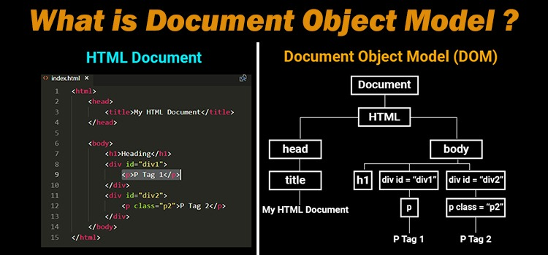
DOM Model

Slide 6
Property Binding
Property binding is used to pass data from the component class (component.ts) and setting the value of the given element in the user-end (component.html).
Property binding is an example of one-way data binding.
The main advantage of property binding is that it facilitates you to control elements property.
Here we use [ ] (square brackets) for Property Binding.

Slide 7
Property Vs Attribute:
Html Attributes and Dom Properties are not Same.
Attributes defined by Html.
Properties defined by DOM.
Attributes initialize DOM properties and then they are done.
Attribute values cannot change once they are initialized.
Property values however can change.

Slide 8
Thank you
Presented By
Patnana Santosh Kumar

